Slide 1
Digital Portfolio
STUDENT NAME: HARSHINI M
REGISTER NO AND NMID: asbruce2422j1180
DEPARTMENT: BCA
COLLEGE: COLLEGE/ UNIVERSITY: Bharathiar University

Slide 2
PROJECT TITLE DIGITAL PORTFOLIO

Slide 3


AGENDA
Problem Statement
Project Overview
End Users
Tools and Technologies
Portfolio design and Layout
Features and Functionality
Results and Screenshots
Conclusion
Github Link
3/21/2024 Annual Review

Slide 4

PROBLEM STATEMENT
Many professionals and creatives struggle to effectively showcase their skills, projects, and experience in a way that is easily accessible, visually appealing, and tailored to different devices. There is a need for a responsive digital portfolio website that presents this information clearly, provides smooth navigation, and includes features like dark mode to enhance user experience and accessibility, helping individuals stand out and connect with potential employers or clients.

Slide 5

PROJECT OVERVIEW
This project involves designing and developing a personal digital portfolio website to showcase a web developer’s skills, projects, and professional background. The portfolio is built with modern web technologies and features a clean, responsive design that works well on both desktop and mobile devices. Key functionalities include smooth navigation, a dark mode toggle for better accessibility, and clearly organized sections such as About Me, Skills, Projects, Resume, and Contact. The goal is to create an engaging and professional online presence that effectively communicates the developer’s capabilities to potential employers or clients.

Slide 6

WHO ARE THE END USERS?
Hiring Managers: Seeking detailed information about your qualifications and past projects to make informed recruitment decisions.
Clients: Looking to assess your capabilities and portfolio before engaging your services for web development work.
Industry Peers: Interested in your technical skills and projects for collaboration or networking purposes.
Visitors & Enthusiasts: Anyone curious about your work, skills, or background, including friends, family, or potential mentors.

Slide 7

TOOLS AND TECHNIQUES
HTML → For structuring
CSS → For styling
JavaScript → For interactivity

Slide 8
POTFOLIO DESIGN AND LAYOUT
Clean and simple design
Responsive layout for all devices (desktop and mobile)
Clear navigation menu at the top
Sections like About, Skills, Projects, Resume, and Contact
Skills shown as colored tags/badges
Projects listed clearly for easy reading
Dark mode toggle for better viewing in different light
Neat and professional appearance
8

Slide 9
FEATURES AND FUNCTIONALITY
Mobile-friendly and adjusts to any device
Easy-to-use navigation menu at the top
Light and dark mode switch for user preference
Organized sections to showcase personal info and work
Visual skill tags for quick skill recognition
Project descriptions highlighting key work
Downloadable resume link for easy access
Contact links for email and social profiles
Smooth scrolling for seamless browsing experience

Slide 10
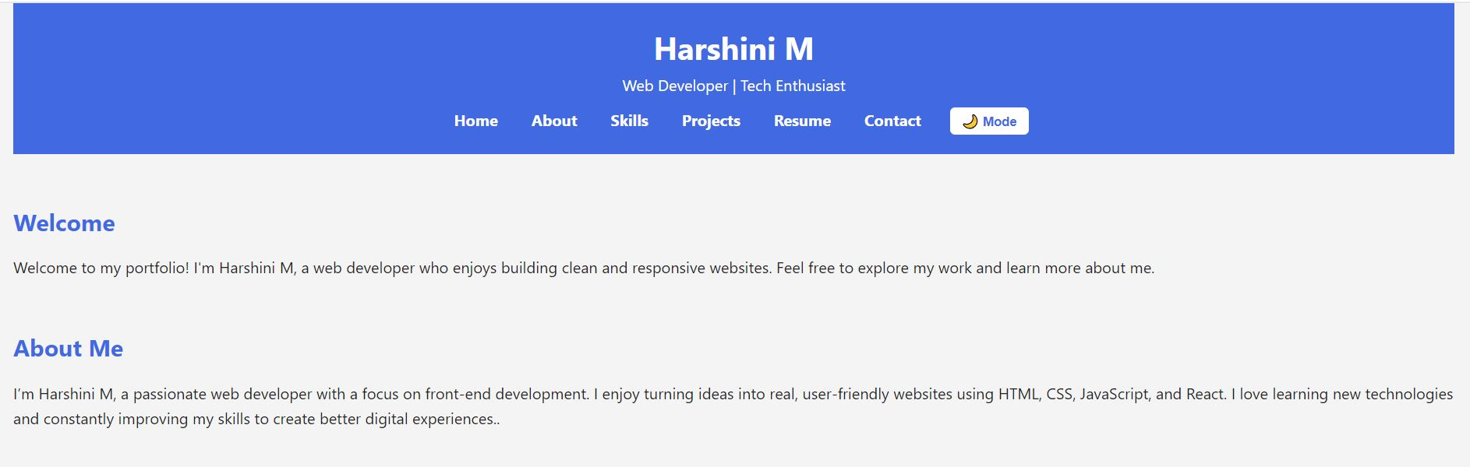
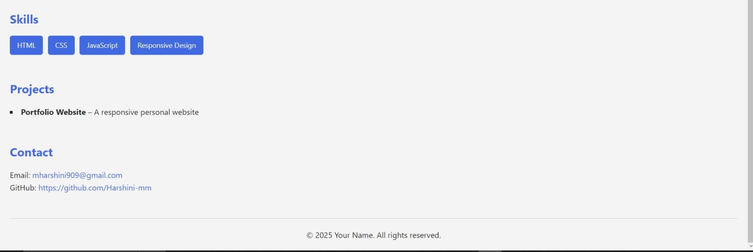
RESULTS AND SCREENSHOTS
3/21/2024 Annual Review
10

Slide 11
GITHUB LINK https://github.com/Harshini-mm
11

Slide 12
CONCLUSION
This digital portfolio effectively showcases my skills, projects, and professional background in a clear and organized way. It provides a smooth and responsive experience across all devices, with a dark mode feature for user comfort. Overall, it serves as a strong online presence to connect with potential employers, clients, and collaborators.
12

